Slide 1

Present Simple-Present Continuous
(тренажёр)

Slide 2
Choose the right variant:
1. My friend usually …football after school.
play
plays
is playing

Slide 3
Choose the right variant:
2. I … hockey most of all.
like
likes
am liking

Slide 4
Usually
Present Simple
He | V | s(es)
She
It

Slide 5
Present Simple
I
You | + V
WE
They

Slide 6
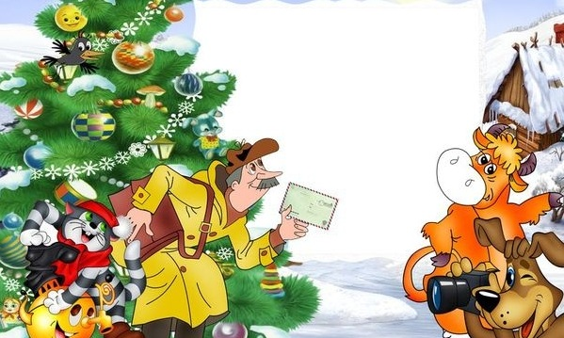
Choose the right variant:
3. Look! They … at the stadium.
is running
run
are running

Slide 7
Look! Listen!
You
We | are | Ving
They

Slide 8
Choose the right variant:
4. He … to the gym twice a week.
go
goes
is going

Slide 9
Choose the right variant:
5. She is in the swimming pool. She … now.
is swimming
am swimming
swims

Slide 10
Now, at the moment
Present Continuous
He
She | is | Ving
It

Slide 11
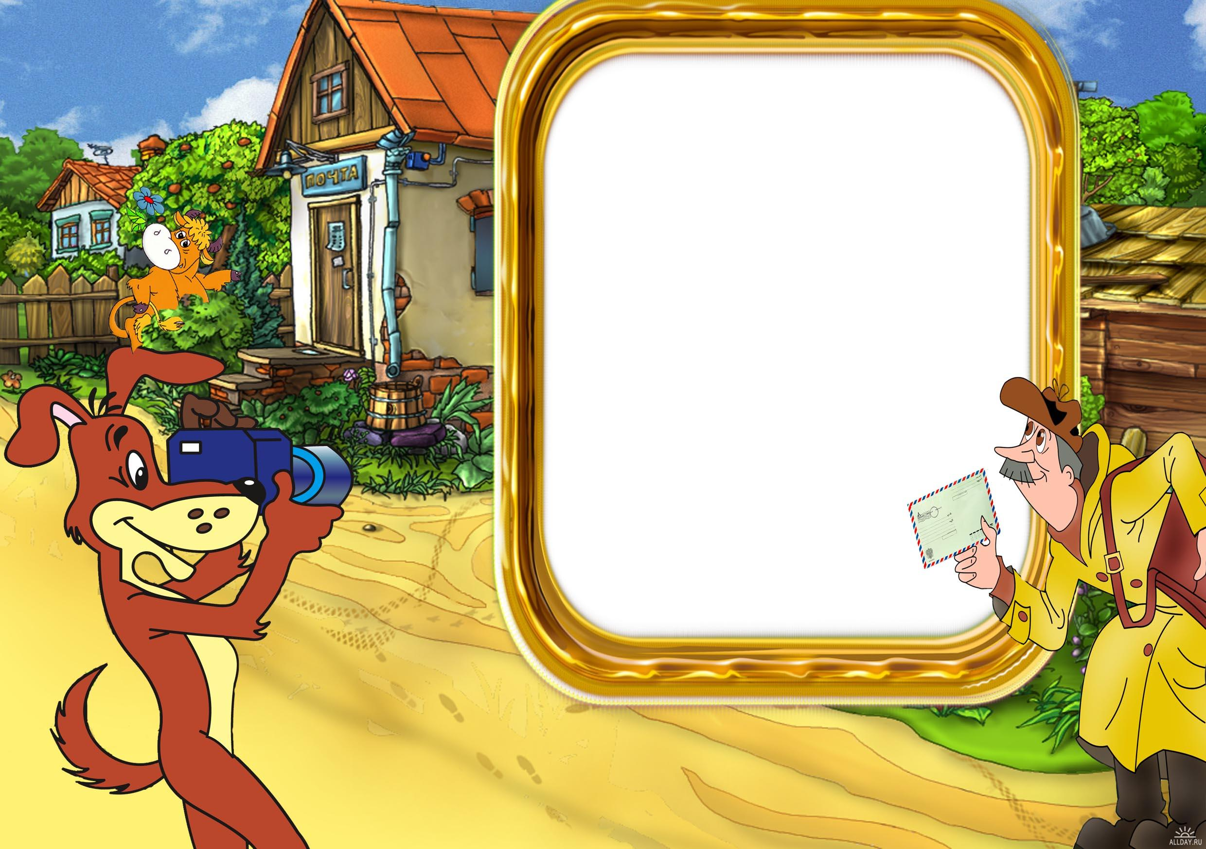
Choose the right variant:
6. They …basketball every Saturday.
are playing
plays
play

Slide 12
Every
Present Simple
I
You | + V
WE
They

Slide 13
Choose the right variant:
7. Can he … a horse?
rides
ride
is riding

Slide 14
Can+ V

Slide 15
Choose the right variant:
8. What games … she like to play?
does
do
is

Slide 16
Questions
Present Simple
 | he
Does | she | V
 | it

Slide 17
regular actions
Present Simple
He | V | s(es)
She
It

Slide 18
Well done!

